Slide 1
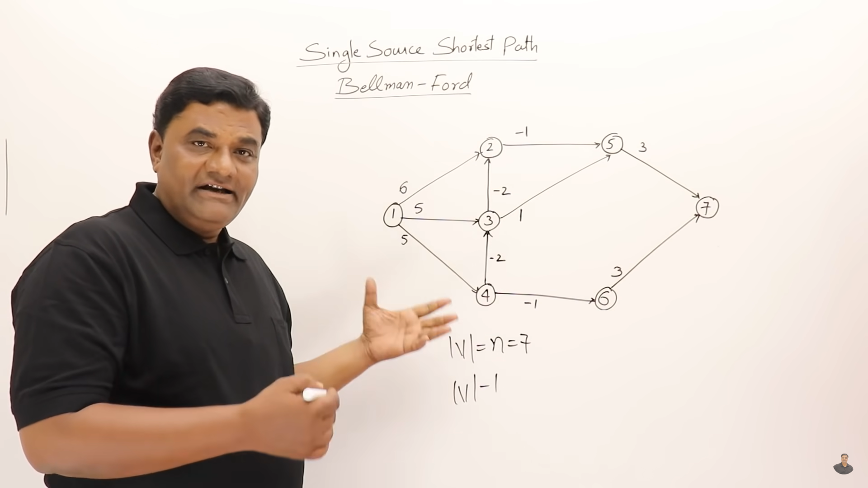

Slide 2
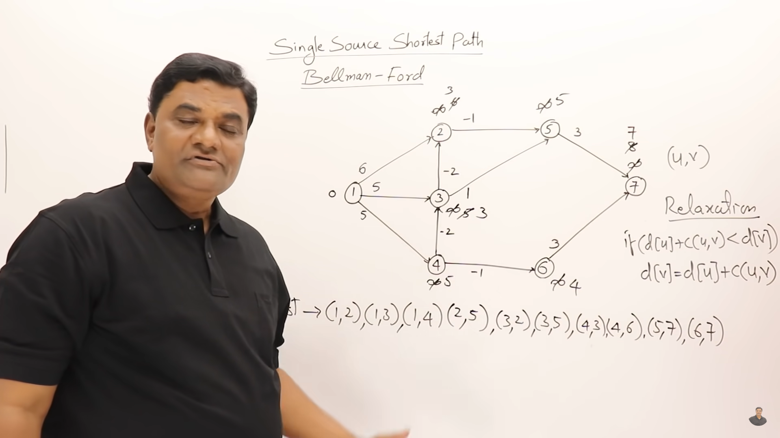
Loop 1

Slide 3
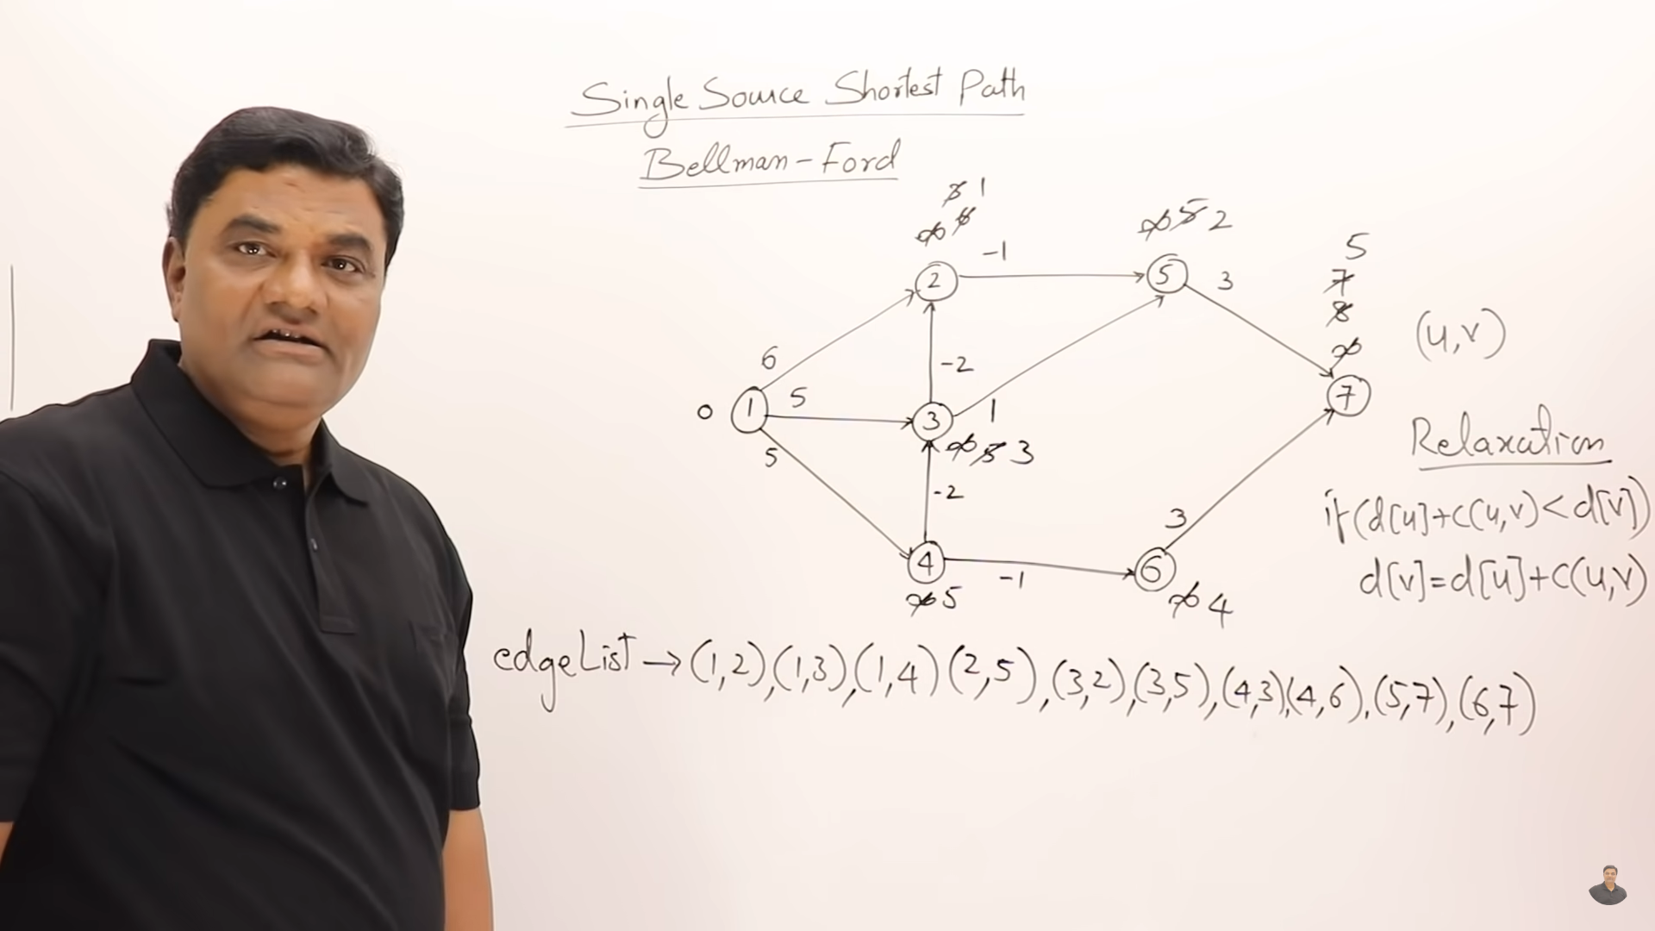
Loop 2

Slide 4
https://www.geeksforgeeks.org/bellman-ford-algorithm-dp-23/

Slide 5
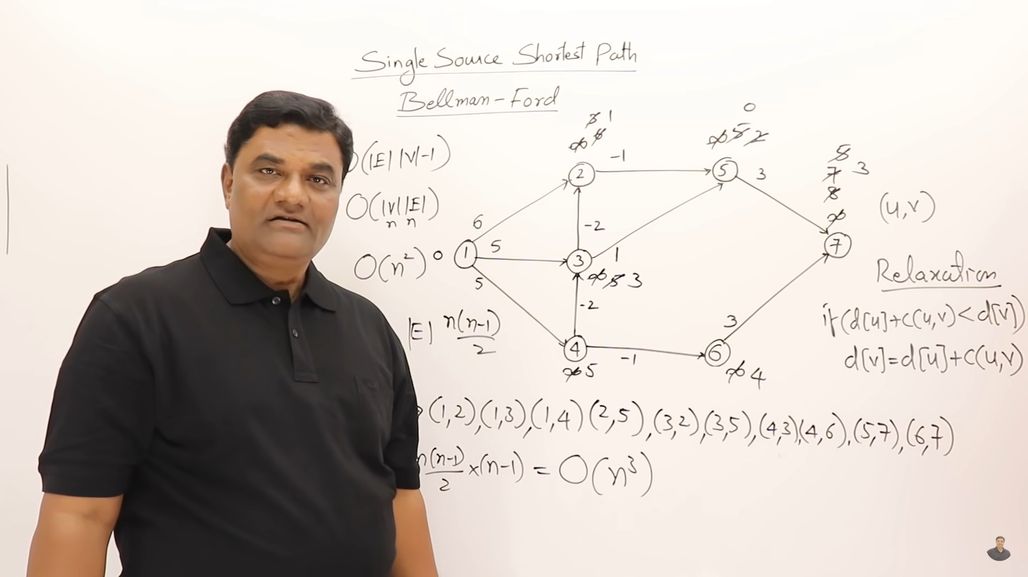

Slide 7
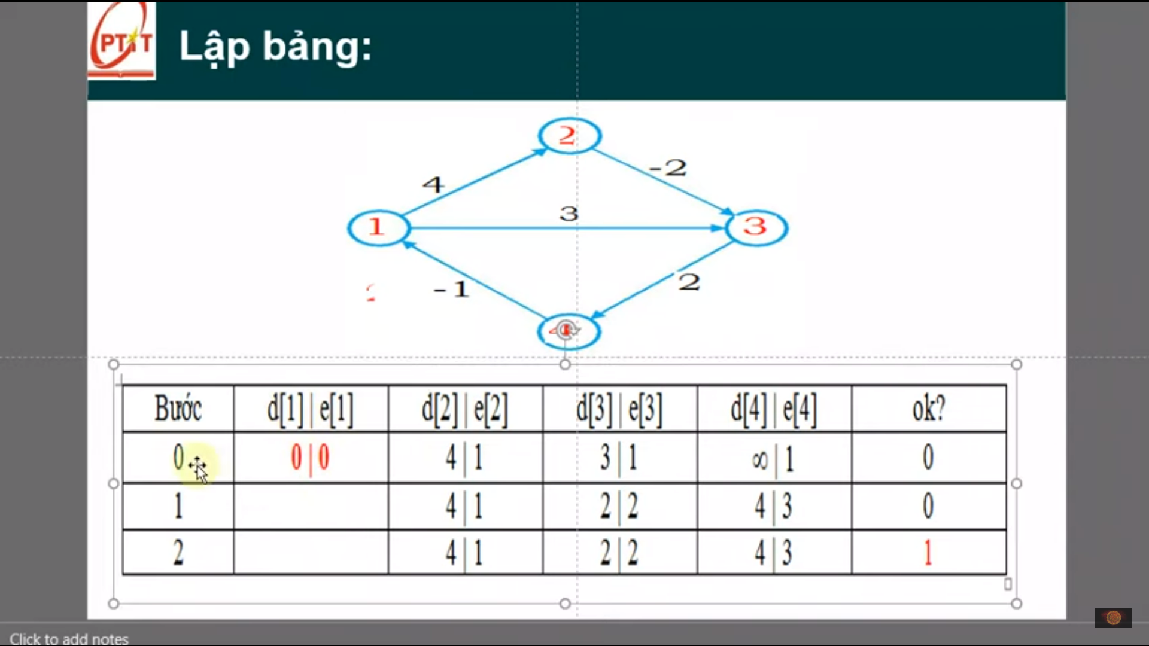
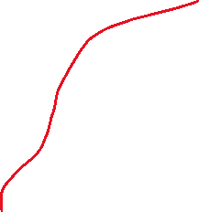

Another path from 1-3 => 1-2-3 cost is 2
Khoang cach /dinh tuong ung
Another path from 1-4 => 1-3-4 or 1-2-3-4 chose 1-2-3-4
Khi 1 gtri thay doi ok =0
Khong co gia tri cap nhat moi => ok =1

Slide 8
